Slide 1

FIRST REVIEW AgriVision: Advancing Agriculture with CNN (GAN Model) -Based Leaf Disease Detection Project Category: RESEARCH
Guide Name Student Name & Registration Number
Dr. A. Sasi Kumar
A.V.N. Akhila RA2111027010029​
Vyshnavi Nagella RA2111027010034​
Snehal Sukundari RA2111027010049​
Seyjuti banerjee RA2111027010052

Slide 2
Introduction
Agriculture plays a vital role in the global economy, and the health of crops is paramount to ensure high yields and food security. Leaf diseases are a major threat to agricultural productivity, leading to significant economic losses and food shortages. Traditional methods of detecting leaf diseases are labor-intensive and often require expert knowledge. With advancements in technology, specifically in machine learning and deep learning, it is now possible to automate and enhance the accuracy of leaf disease detection. This project aims to develop an efficient and reliable system for detecting leaf diseases using Convolutional Neural Networks (CNNs) – GAN Model.

Slide 3
Abstract
This project focuses on the development of a leaf disease detection system utilizing Convolutional Neural Networks (CNNs) – GAN Model. By capturing and analyzing images of leaves, the system can identify various diseases and nutrient deficiencies with high accuracy. The primary goal is to provide farmers with a cost-effective and easy-to-use tool that can help them monitor and manage the health of their crops more effectively. The project encompasses data collection, model training, and deployment of the CNN(GAN model) -based detection system.

Slide 4
Motivation
The motivation behind this project stems from the significant impact that leaf diseases can have on agricultural productivity. By providing farmers with a reliable tool for early disease detection, this project aims to:
Minimize crop losses due to diseases.
Reduce the dependency on chemical pesticides by enabling targeted treatments.
Empower farmers with technology to make informed decisions about crop management.
Contribute to global food security by improving agricultural practices.

Slide 5
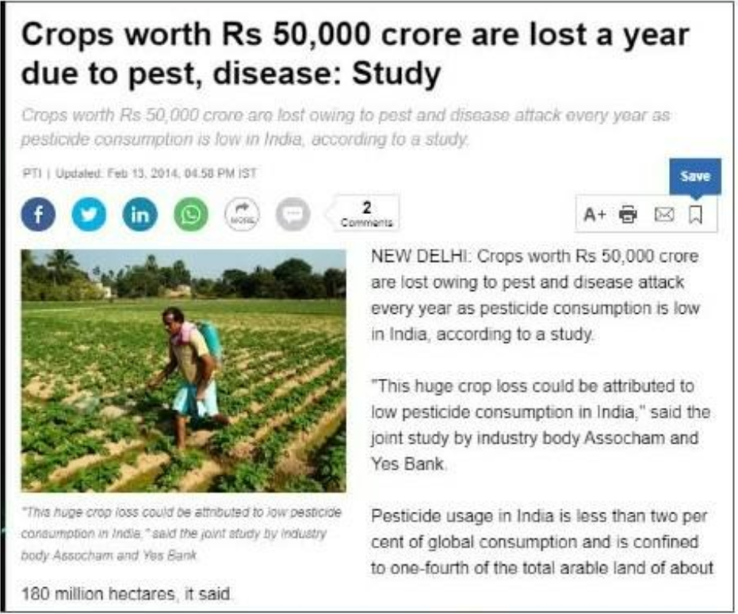

Slide 6
Purpose Of The Project
The purpose of this project is to leverage the power of CNNs(GAN model) to develop a robust system for detecting leaf diseases. The system aims to assist farmers by:
Providing early detection of diseases, allowing for timely intervention.
Reducing the need for manual inspection by agricultural experts.
Enhancing crop management practices, leading to increased yields and reduced losses.

Slide 7
Scope Of The Project
Collection of a comprehensive dataset of leaf images representing various diseases and healthy conditions.
Development and training of a CNN (GAN model) to accurately classify different types of leaf diseases.
Integration of the model into a user-friendly application that can be used by farmers for real-time leaf health monitoring.
Evaluation of the system's performance in real-world scenarios and refinement based on feedback.

Slide 8
Literature Survey - 1
S. No | Title | Methodology Summary and Findings | Identification of Gaps and Limitations
1. | Application of Deep Learning to IoT Data (J. Appl. Sci. 12, 6982) | This study employs machine learning algorithms to predict crop yield based on various factors such as soil quality, weather conditions, and crop management practices. Key findings indicate that the use of AI can significantly enhance the accuracy of yield predictions, leading to better resource management and higher productivity. | The study primarily focuses on the technical aspects of deep learning implementation and lacks a comprehensive analysis of the integration challenges within existing IoT infrastructures. Additionally, the paper does not address the economic feasibility and scalability of the proposed solutions.

Slide 9
Literature Survey - 2
S. No | Title | Methodology Summary and Findings | Identification of Gaps and Limitations
2. | Review on Automated Plant Disease Detection (J. Plant Dis. Prot. 128, 19–53) | This review paper compiles various automated plant disease detection techniques, focusing on image acquisition, preprocessing, segmentation, feature extraction, and classification methods. The findings highlight the efficacy of machine learning and deep learning models, particularly CNNs, in accurately detecting and classifying plant diseases. The review also discusses the importance of dataset quality and real-time application challenges. | The review identifies several gaps, including the lack of standardized datasets and the need for more robust image preprocessing techniques to handle diverse real-world conditions. It also points out the challenge of developing universally applicable models that can accurately detect diseases across different plant species and environmental conditions.

Slide 10
Literature Survey - 3
S. No | Title | Methodology Summary and Findings | Identification of Gaps and Limitations
3. | Image-Based Plant Disease Identification Using Deep Learning (J. Big Data 11, 5) | This study presents a deep learning-based system for identifying plant diseases using images of affected leaves. The methodology involves the use of CNN architectures such as AlexNet and InceptionV3 for feature extraction and classification. The research demonstrates high accuracy rates, with some models achieving over 95% accuracy in controlled experiments. The study emphasizes the potential of deep learning to transform agricultural diagnostics. | The primary limitations include the reliance on high-quality, labeled training datasets, which are not always available. The study also notes the challenge of adapting models trained in controlled environments to field conditions, where variables such as lighting, background, and leaf orientation can vary significantly.

Slide 11
Literature Survey - 4
S. No | Title | Methodology Summary and Findings | Identification of Gaps and Limitations
4. | Machine Learning for Plant Disease Detection (J. Plant Dis. Prot. 128, 19–53) | This paper explores various machine learning techniques for detecting plant diseases, including SVM, k-NN, and deep learning models like CNN. The findings indicate that machine learning models can effectively classify diseases with high accuracy, particularly when combined with advanced image processing techniques. The study also highlights the role of feature extraction methods in improving model performance. | The study identifies gaps related to the scalability of machine learning models for large-scale agricultural applications. It also points out the need for more extensive field testing to validate the models under diverse environmental conditions. Additionally, there is a call for more research on the integration of these models with IoT devices for real-time monitoring.

Slide 12
Literature Survey - 5
S. No | Title | Methodology Summary and Findings | Identification of Gaps and Limitations
5. | Plant Disease Detection using Generated Leaves Based on DoubleGAN | The study employed a two-stage GAN (DoubleGAN) to generate 256x256 pixel plant leaf images to expand an unbalanced dataset. The expanded dataset was then used to classify plant species and diseases using VGG16, ResNet50, and DenseNet121 models. The classification accuracy for the dataset expanded with DoubleGAN was higher than for the original dataset and slightly better than for the dataset expanded by traditional methods like flipping and translation. | The study suggests that while the generated images by GANs can balance the dataset, further work is needed to generate higher resolution images with fewer samples..

Slide 13
Literature Survey - 6
S. No | Title | Methodology Summary and Findings | Identification of Gaps and Limitations
6. | A Data Augmented Method for Plant Disease Leaf Image Recognition based on Enhanced GAN Model Network | The study developed an enhanced GAN model using the Wasserstein GAN loss function, incorporating a self-attention layer to improve the generation of plant disease leaf images. The model was tested using the PlantVillage dataset, and the results showed that the AWGAN model significantly improved the recognition accuracy of maize leaf diseases, achieving 98.4% accuracy with the ResNet18 network. | The method efficiently addresses the overfitting issue in small sample training sets, but the study highlights the need for further research in generating images under varying real-world conditions and for different plant species.

Slide 14
Literature Survey - 7
S. No | Title | Methodology Summary and Findings | Identification of Gaps and Limitations
7. | Automatic Plant Disease Detection Based on Tranvolution Detection Network With GAN Modules Using Leaf Images | The study introduced a Tranvolution detection network with GAN modules to improve the accuracy and speed of plant disease detection.- Methodology includes the combination of CNN and Transformer architectures, and integration of GANs for image preprocessing and feature extraction.- Achieved a precision of 51.7%, recall of 48.1%, and mAP of 50.3%.- The model was validated on the PlantDoc dataset. | The model's performance decreases with small-scale objects and highly dense detection scenarios.- There is some mislabeling due to the model's focus on detecting all objects, which can lead to false positives.- High computational complexity, making it challenging to deploy on mobile devices.

Slide 15
Literature Survey - 8
S. No | Title | Methodology Summary and Findings | Identification of Gaps and Limitations
8. | Comparison of Deep Learning-Based Models for Leaf Disease Detection | Evaluated various deep learning models such as YOLO, SSD, and EfficientDet for leaf disease detection.- Methodology involved training and testing these models on the PlantDoc dataset with different input sizes.- YOLOv5 outperformed other models in terms of precision, recall, and mAP | Performance degradation in small object detection.- Most models struggle with high-density object scenarios, leading to reduced accuracy.- Lack of generalized models capable of performing equally well across different plant species and disease types.

Slide 16
Methodology
--Self-Attention in Neural Networks:
Enhances image generation in GANs by improving global feature recognition.
Introduces convolution channels (F, G, H) for better attention capture.
--Wasserstein Distance in GANs:
Measures difference between real and generated data in WGANs.
Stabilizes training and improves image generation accuracy.-
--AWGAN Network Structure:
Combines Wasserstein distance with self-attention for realistic leaf image generation.
Operates in three phases: plant age division, disease stage prediction, and high-resolution image generation.

Slide 17
Methodology
--Methodology:
Uses WGAN for initial 64x64 image generation, followed by SRGAN for 256x256 refinement.
Pretraining and optimization through back-propagation until convergence.
--Application:
Tested on PlantVillage dataset with 31,361 leaf images.
Successfully generated realistic images for plant disease recognition tasks.

Slide 18
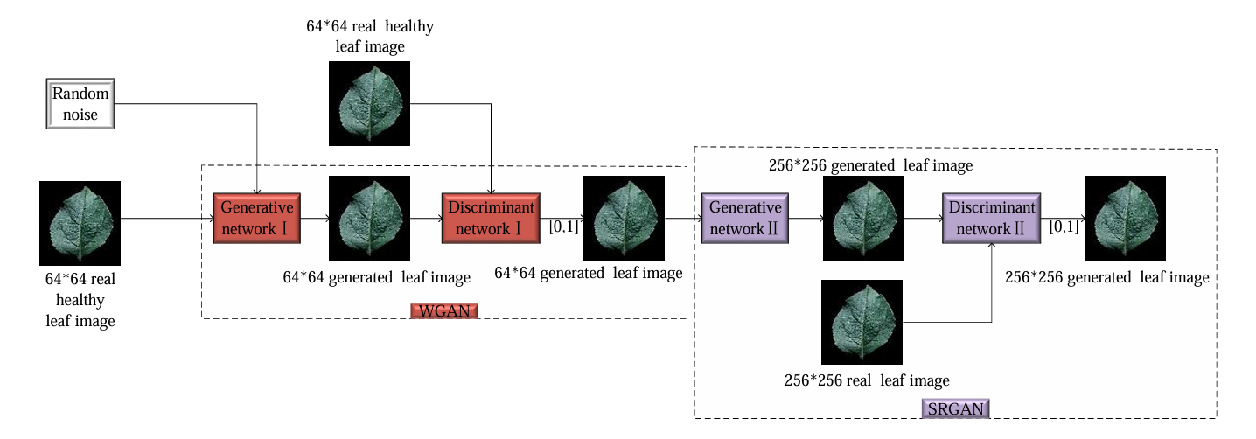
DoubleGAN structural block diagram

Slide 19
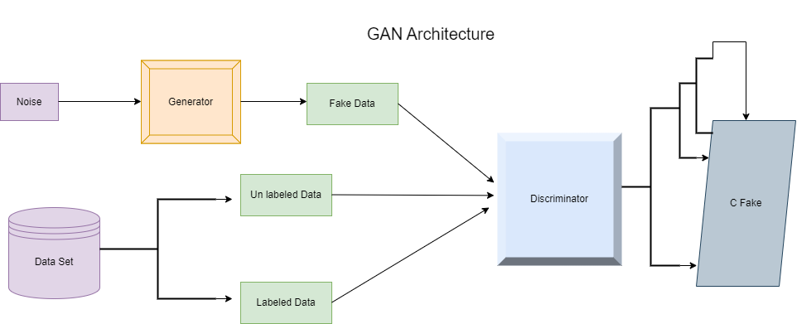
Architecture Diagram

Slide 20
